Slide 1
Bicycle
Taught by Yossef Ayman Zedan

Slide 2
Navbar
We will take this Navbar: https://getbootstrap.com/docs/5.1/components/navbar/#supported-content
Add font-monospace position-absolute w-100 and style="z-index: 40;” to be over the video content

Slide 3
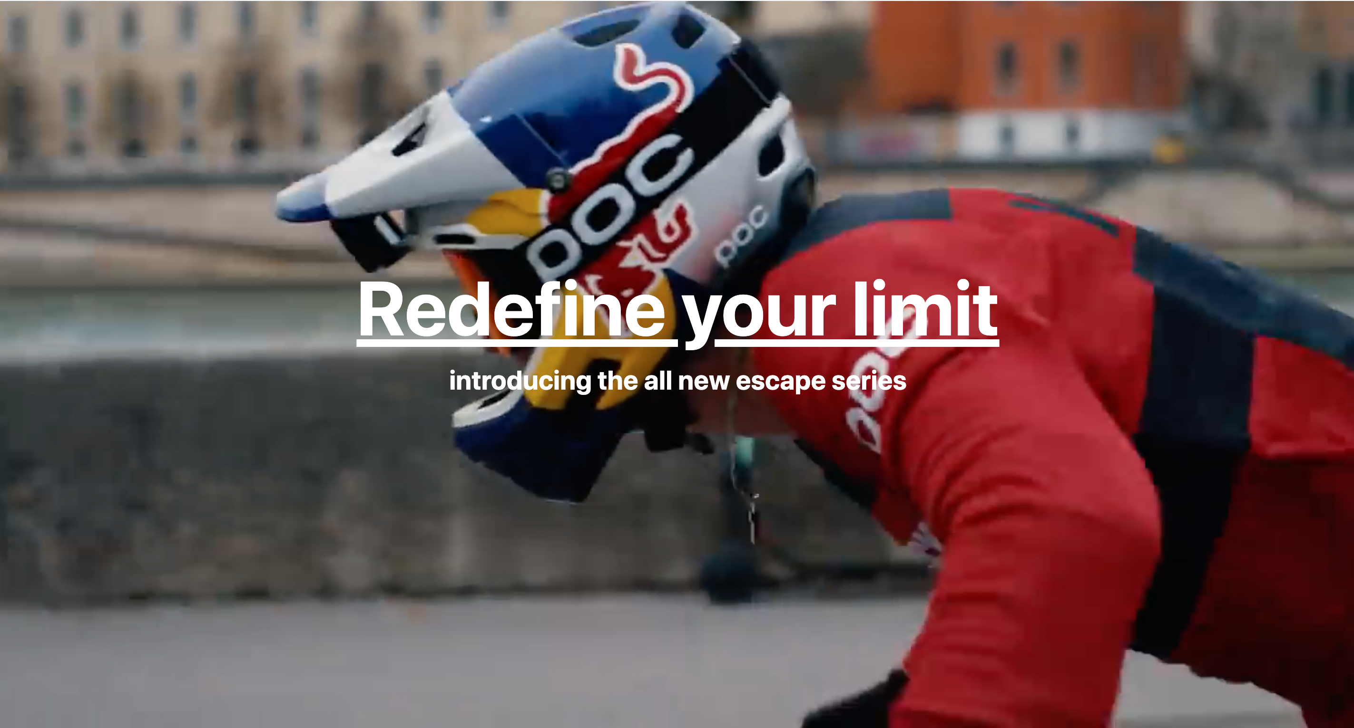
Home section - Video

Slide 4
Home section - Video
The video section that most of people think that we add backround-image: url();
NO!. We add <video src="" autoplay loop playsinline muted></video> inside section: .video-container
which is the video tag in HTML5. Playsinline: A Boolean attribute indicating that the video is to be played "inline", that is within the element's playback area.
.video-container{
height: 100vh;
position: relative;
overflow: hidden; }
video {
-o-object-fit: cover;
object-fit: cover;
position: absolute;
height: 100vh;
width: 100vw; }

Slide 5
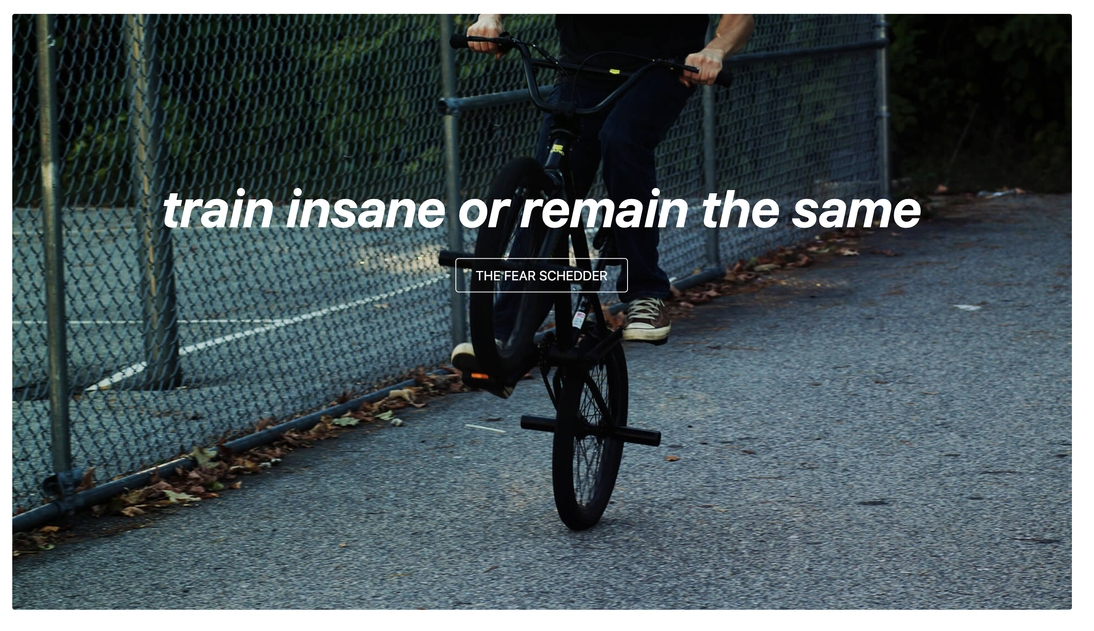
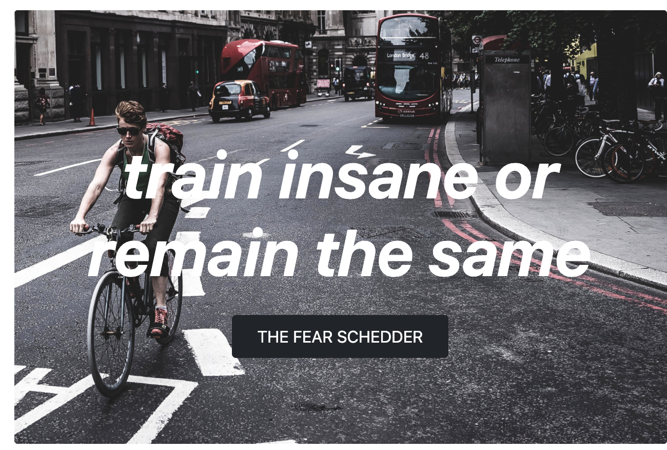
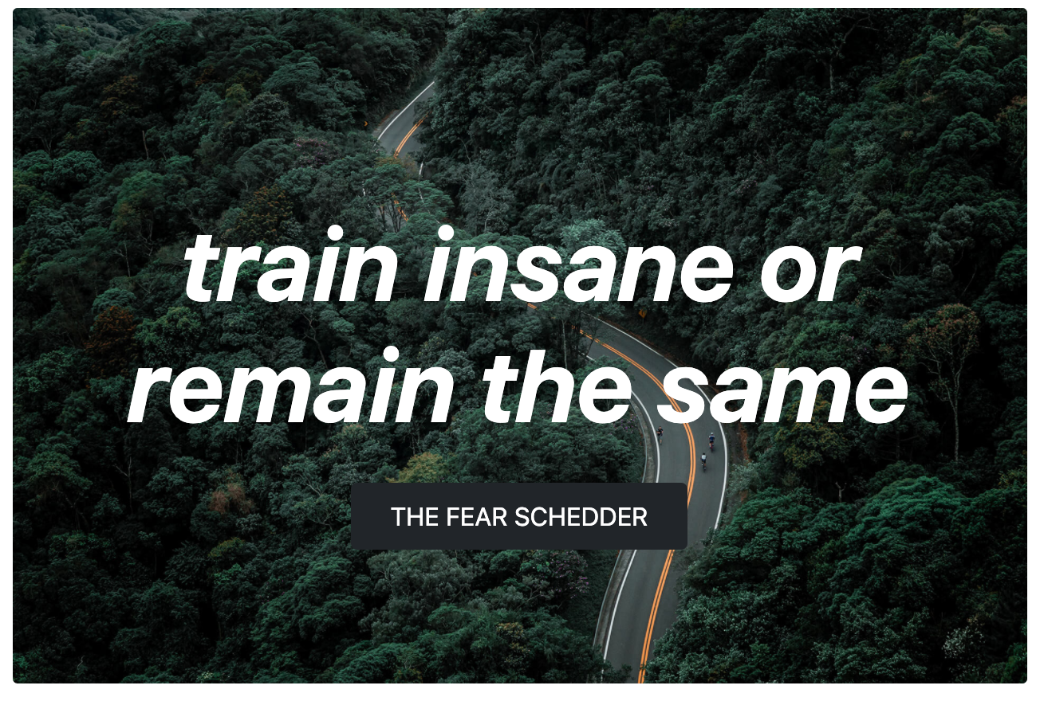
Portfolio section

Slide 6
Portfolio section
We will use container, row align-items-center.
The first card has no column but the second two cards have: col-xl-6 mt-5
It consists of 3 cards with image overlay with additional classes to customize the content: https://getbootstrap.com/docs/5.1/components/card/#image-overlays
<div class="card-img-overlay position-absolute top-50 translate-middle-y text-center">

Slide 7
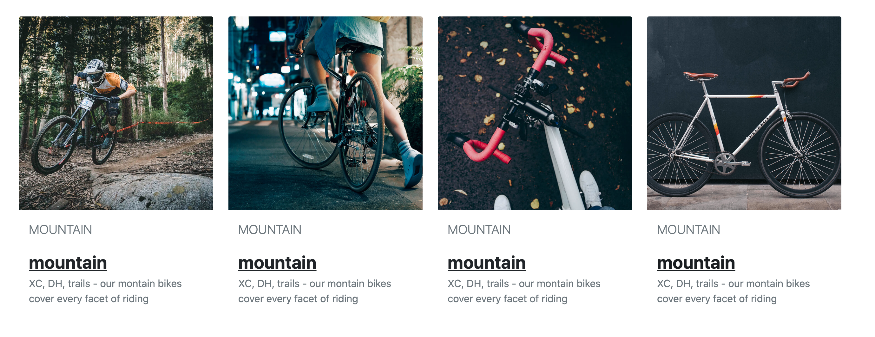
Portfolio section part 2

Slide 8
Portfolio section part 2
We will add container, row with mt-5 and col-lg-3 col-6
We will take this card: https://getbootstrap.com/docs/5.1/components/card/#example and add borde—0
<div class="card border-0">, content and <a> tag with stretched link

Slide 9
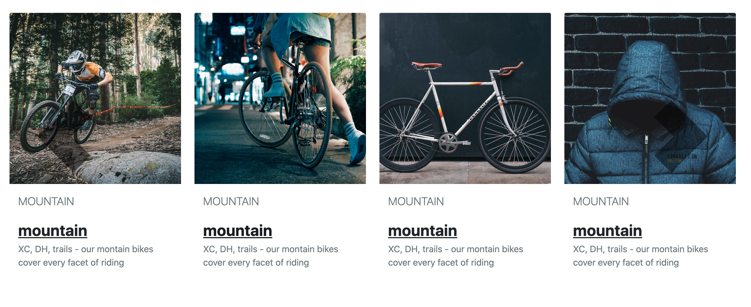
Carousel

Slide 10
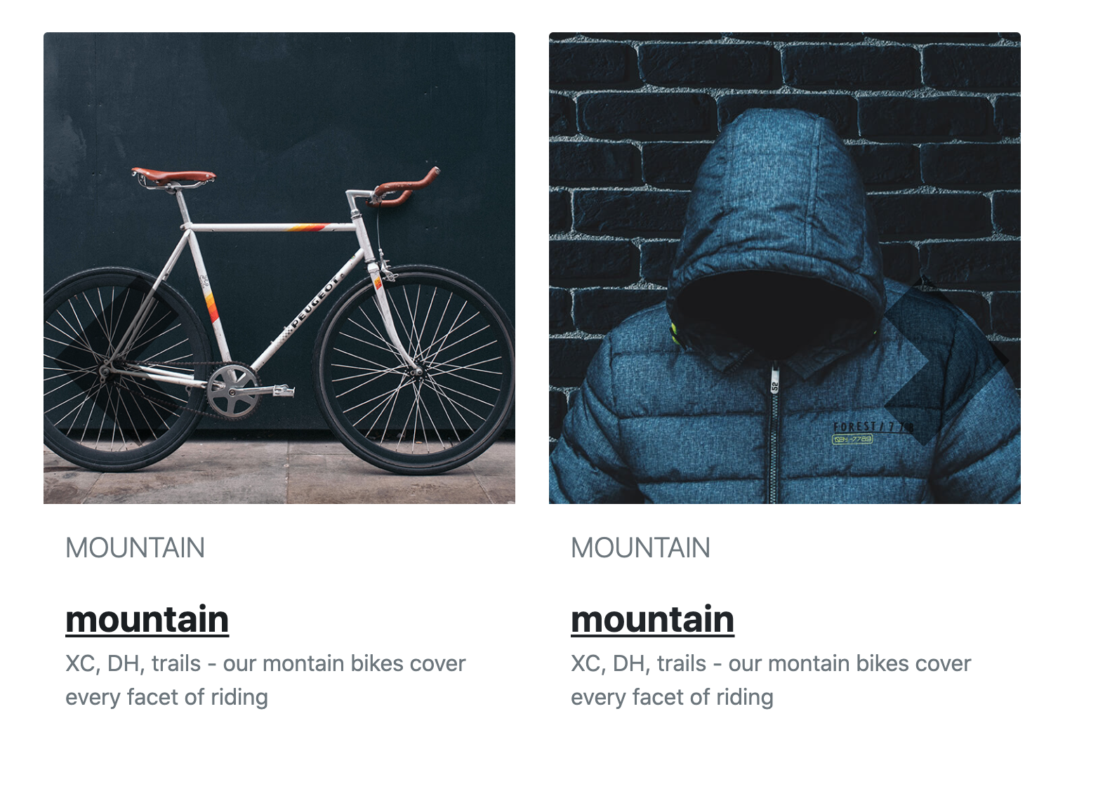
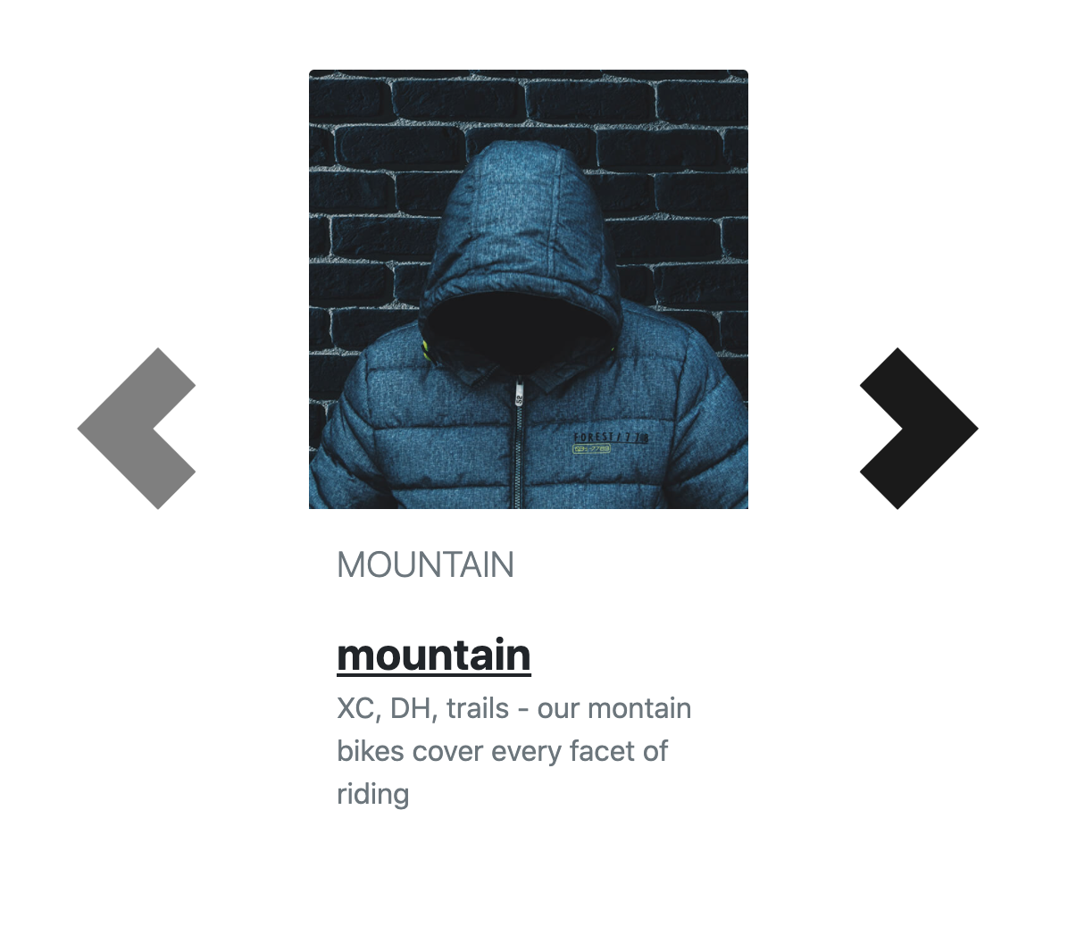
Carousel

Slide 11
Carousel
Some carousel items will disappear when the screen moves from large to small.
Below lg screen, we will see two items.
Below md, just one item.
This is done by controlling the d-lg-block, d-md-block and d-none
We will use: container and copy this carousel inside: https://getbootstrap.com/docs/5.1/components/carousel/#with-controls

Slide 12

Footer

Slide 13
Footer
We use:
1- <footer class="py-5 bg-dark text-white">
2- container, row justify-content-center and three col-md-4
3- First column has <div class="col-md-4 mb-lg-0 mb-4">
4- Second and third columns have <div class="col-md-4 col-6">

